Slide 1
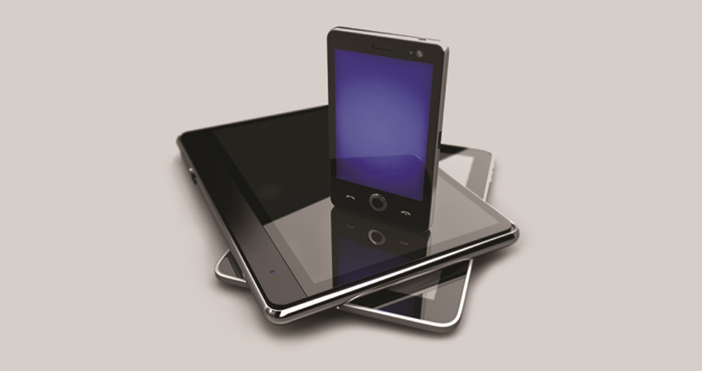
IT Essentials (CompTIA A+) Ch. 25
Understanding Mobile Devices

Slide 2
Overview
In this chapter, you will learn how to:
Explain the features and capabilities of mobile devices
Describe the three major mobile operating systems
Describe how to configure mobile devices
Notes:
2
When gaining attention and establishing common ground, ask questions of the class such as, “How do mobile devices connect to the Internet?” or “Who are the two major mobile operating system providers?”
For a WIIFM statement, say to the class, “People use mobile devices for some of the same things as PCs—checking e-mail, surfing the Internet, and even doing some business with them. Mobile devices are very similar to PCs, but also very different. They have different features, different operating systems, and even connect to the Internet in different ways. Knowing the basics of how mobile devices work will help you understand all of the different ways people use and need computers.”

Slide 3
Introduction
It’s not easy to find a definition of mobile device that everyone agrees on.
Lightweight, usually less than two pounds
Small, designed to move with you (in your hand or pocket)
Touch or stylus interface; no keyboard or mouse
Sealed unit lacking any user-replaceable parts
Non-desktop OS; mobile devices that use special mobile operating systems

Slide 4
Mobile Computing Devices
Device variants
Most modern mobile devices fall into one of a few categories:
Smartphones
Tablets
Phablets
Wearable technology
Other mobile devices are purpose-built to be better at some task such as an e-reader.

Slide 5
Smartphones
One of the earliest types of mobile device was the personal digital assistant (PDA).
Smartphone
Multi-touch interface
Well-standardized application programming interface (API)
Consolidation of cellular data to the device, enabling data exchange over the Internet
Synchronization and distribution tools that enable users to install new apps and synchronize or back up data

Slide 6
Smartphones
Most smartphones run one of the big three operating systems:
Apple iOS, Google Android, or Microsoft Windows Phone/10 Mobile
Smartphones typically have no user-replaceable or field-replaceable components.
Must be taken to a specialized (and in some cases, authorized) service center for repair

Slide 7
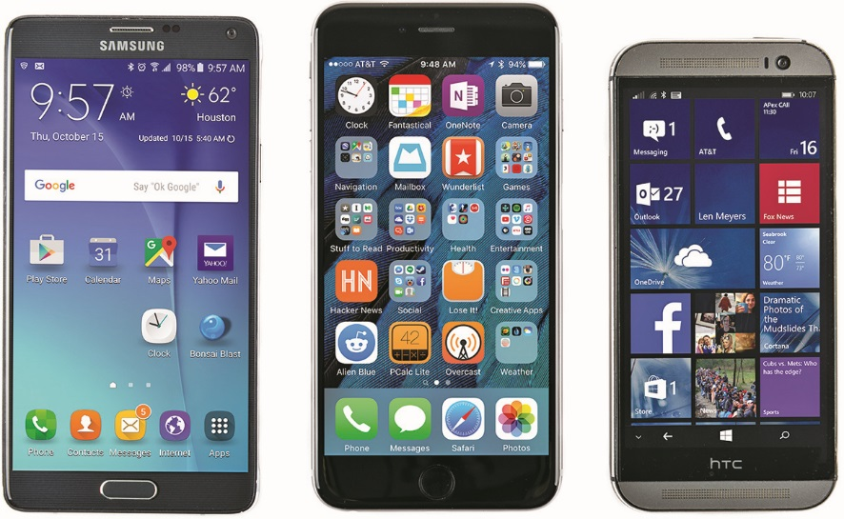
Smartphones
Figure 25.3 Examples of the big three smartphone OSs: Android (left), iOS (center), and Windows Phone (right)

Slide 8
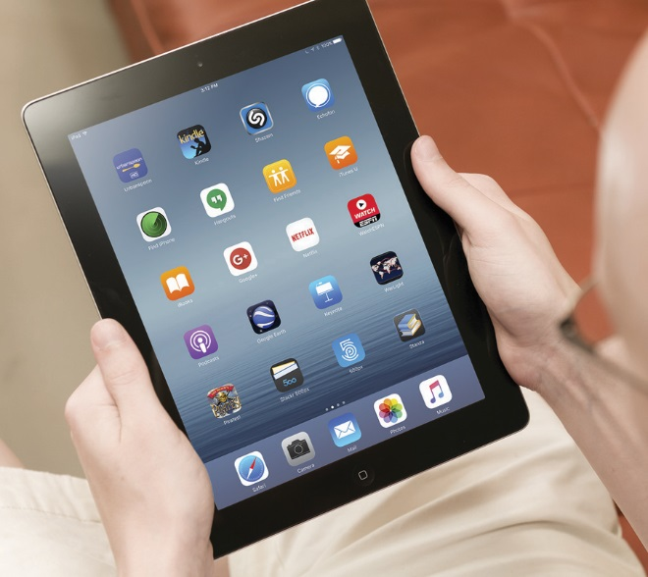
Tablets
Tablets are very similar to smartphones; they run the same OSs and apps, and use the same multi-touch screens.
Generally lack cellular connection
Figure 25.4 Typical tablet

Slide 9
Phablets
Phablets straddle the line between tablets and smartphones.
They provide all the features of a smartphone with the expansive vistas of a huge screen.
Screen sizes range from 5.5 to 6.5 inches.

Slide 10
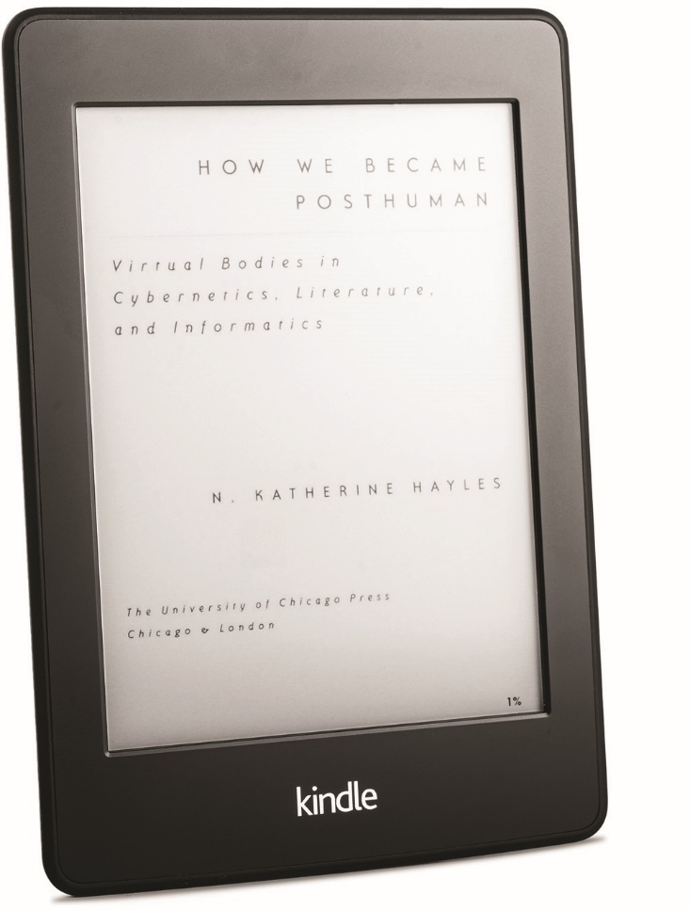
Purpose-Built Mobile Devices
E-readers
An e-reader is a device designed for reading electronic books.
An e-reader uses a low-power gray-scale screen technology called e-paper, and a simple interface.
Figure 25.6 Kindle Paperwhite e-reader

Slide 11
Purpose-Built Mobile Devices
Wearable technology devices
Very small; almost always well under a pound, usually a few ounces
Small interfaces; screens less than 2 inches, often much less
Light OSs used to perform a small subset of functions of a typical mobile device OS
Limited hardware, although accelerometers are very common (for step counting)
Pairs with a host device (often a smartphone)

Slide 12
Purpose-Built Mobile Devices
Smart watches
A smart watch minimizes the effort of frequent smartphone tasks.
Controlling music playback or checking e-mail, texts, notifications, time, and weather
Fitness monitors
A growing number of fitness monitors or trackers aim to help you meet your fitness goals.
The Global Positioning System (GPS) network tracks your exercise.

Slide 13
Purpose-Built Mobile Devices
Glasses/headsets
Wearable glasses and headsets haven’t made it to the mainstream yet.
Google Glass presents privacy issues.
Microsoft HoloLens is a compact Windows 10 computer in a single set of glasses.
From a technician’s perspective, there are typically no user-replaceable parts in wearable devices.
Must send these devices to an authorized service center to be repaired or replaced

Slide 14
Mobile Hardware Features
Screen technologies
Most tablets use some type of LCD panel, just like portable devices and desktop monitors.
Twisted nematic (TN)
In-Plane Switching (IPS)
Some smaller devices, like the better smartphones, use a related technology—organic light-emitting diode (OLED)—that lights the screen with an organic compound.

Slide 15
Mobile Hardware Features
Cameras
Many mobile devices have distinct front-facing and rear-facing cameras.
Modern smartphone camera features include high dynamic range (HDR), light compensation, and other functions that enable the user to finely tune a photo or video.
Smart cameras are best thought of as bringing together the interface, operating system (typically Android), networking, and apps of a smartphone with a dedicated digital camera.

Slide 16
Mobile Hardware Features
Microphones
Mobile devices commonly have more than one microphone to enable noise-cancelling routines to work their magic.
Digitizers
A digitizer refers to the component that provides the “touch” part of a touchscreen.
Transforms analog signals into digital ones

Slide 17
Mobile Hardware Features
Global Positioning System (GPS)
Users rely on location services to conveniently find things near them, such as stores and restaurants.
Many purpose-built GPS devices exist.
Example: GPS-enabled navigational aids for vehicles
Geotracking enables mobile OSs to track and in many cases to record your location for an extended amount of time.
This feature can be turned off.

Slide 18
Big Three Mobile OSs
Development models
Closed source is another way to refer to the traditional practice of making and selling a product without telling anyone how you made it.
The terms proprietary or vendor-specific apply to a closed-source product or technology – something that doesn’t use common, open standards.
A product that is open source means the manufacturer releases instructions for making it.
A manufacturer can put an open-source operating system on an otherwise closed-source device.

Slide 19
Apple iOS
Apple’s closed-source mobile operating system, iOS, runs on the iPhone, iPad, and iPod Touch.
iOS apps are almost exclusively purchased, installed, and updated through Apple’s App Store.

Slide 20
Google Android
Android is an open-source platform, based on yet another open platform, Linux, and is owned by Google.
There are differences among the implementations from various vendors.
Android apps are available to purchase and download through various app stores, such as Google Play and the Amazon Appstore.

Slide 21
Microsoft Windows Phone
Windows Phone is a closed-source operating system, but Microsoft licenses it to device manufacturers for use on their devices.
Microsoft asserts the most control over the OS portion of its platform.
Microsoft maintains its own app store (Windows Phone Store) with its own developer requirements.

Slide 22
Mobile OS Features
User interfaces
All mobile OSs have a graphical user interface (GUI).
Mobile OSs support touch gestures, such as swiping or pinching.
Launchers enable users to customize their Android device extensively.

Slide 23
Mobile OS Features
Most mobile devices include:
An accelerometer to measure movement in space
A gyroscope to maintain proper orientation of up and down
These instruments change the screen orientation when you rotate a device.

Slide 24
Mobile OS Features
Screen calibration
The most obvious screen calibration involves refining the screen’s color output.
Mobile device screens are calibrated before they leave the factory.
It should be sufficient to know that calibration (and miscalibration!) of these features is possible (especially on older devices).
Check device and OS documentation to see if this applies to your device.

Slide 25
Mobile OS Features
Wi-Fi calling
The capability to make both audio and video calls over Wi-Fi networks
Using applications such as Skype, for example, on a tablet that does not have cellular capability, as long as it can make a good Wi-Fi connection

Slide 26
Mobile OS Features
Virtual assistants on the latest smartphones and tablets enable quick, vocal interaction to accomplish common goals.
A virtual assistant is also useful if you must use your smartphone while driving.
Siri
Cortana
Google Now

Slide 27
Mobile OS Features
Software development kits
Most mobile operating systems come with some sort of software development kit (SDK) that you can use to create custom apps or add features to existing apps on the device.

Slide 28
Mobile OS Features
Emergency capabilities
The emergency notification feature enables smartphones to receive broadcasts from national emergency broadcast systems.
Example: the Emergency Alert System (EAS) in the United States.
The Enhanced 911 (E911) system uses GPS and cellular networks to triangulate the location of a phone by:
Its distance from cell towers
Its transmission delay time
Other factors

Slide 29
Mobile OS Features
Mobile payment service
An app connects to your bank information and automatically transfers the funds from your bank to the merchant.
Smartphone manufacturers have started to produce their own payment systems, such as Apple Pay.

Slide 30
Mobile OS Features
Airplane mode
This switch (either an actual hardware switch or a software switch that can be located in the device’s configuration settings) turns off all cellular and wireless services, including Bluetooth.

Slide 31
Mobile OS Features
Radio firmware
PRL, PRI, and Baseband Updates
When a mobile device connects to different carriers’ networks, we say it is roaming.
Your phone’s firmware will receive occasional automatic updates to its Preferred Roaming List (PRL) from the carrier.
CDMA devices may also receive product release instruction (PRI) updates.

Slide 32
Mobile OS Features
IMEI, ICCID, and IMSI
The International Mobile Equipment Identity (IMEI) number is a 15-digit number that uniquely identifies a mobile device.
IMEI numbers are unique to devices using the Global System for Mobile Communications (GSM) family of technologies.
The ICCID number (Integrated Circuit Card Identifier) uniquely identifies a subscriber identity module (SIM).

Slide 33
Mobile OS Features
The International Mobile Subscriber Identity (IMSI) number represents the actual user associated with the SIM.
Used with mobile device management (MDM) software

Slide 34
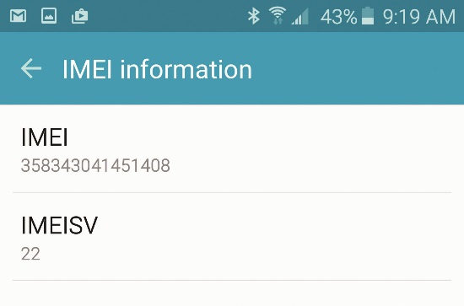
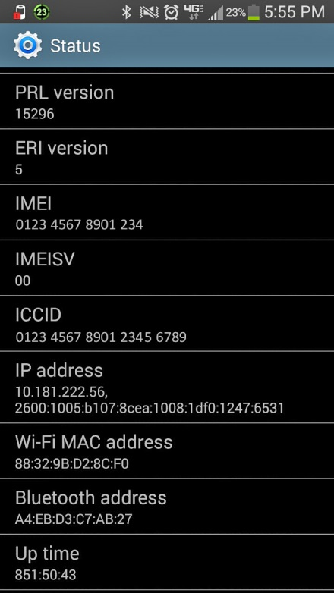
Mobile OS Features
Figure 25.19 IMEI settings on an Android phone
Figure 25.20 IMEI and ICCID numbers

Slide 35
Mobile OS Features
VPN
VPNs establish secure connections between a remote client and the corporate infrastructure, or between two different sites.
The most popular ways to create a VPN are to use either a combination of the Layer 2 Tunneling Protocol (L2TP) and IPsec, or Secure Sockets Layer (SSL).

Slide 36
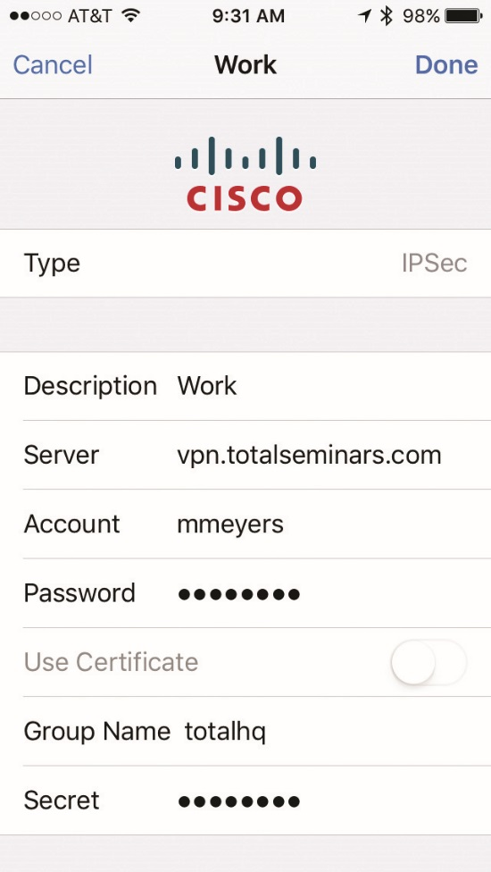
Mobile OS Features
Figure 25.21 Configuring a VPN

Slide 37
Configuring a Mobile Device
Mobile devices require some setup and configuration to function seamlessly in your life.
Devices come preconfigured with everything but your user account and network credentials.
A user still needs to configure corporate e-mail accounts, device add-ons, apps, synchronization settings, and other advanced features.

Slide 38
Enhancing Hardware
A mobile device has the same basic components and does the same basic things as a computer.
System on a chip (SoC) combines a CPU, GPU, and sundry other support logic onto a single silicon die.
Mobile devices use storage, commonly a solid-state drive (SSD) or microSD card.
Mobile devices do not offer any user-replaceable parts.
You can’t upgrade mobile devices at all.

Slide 39
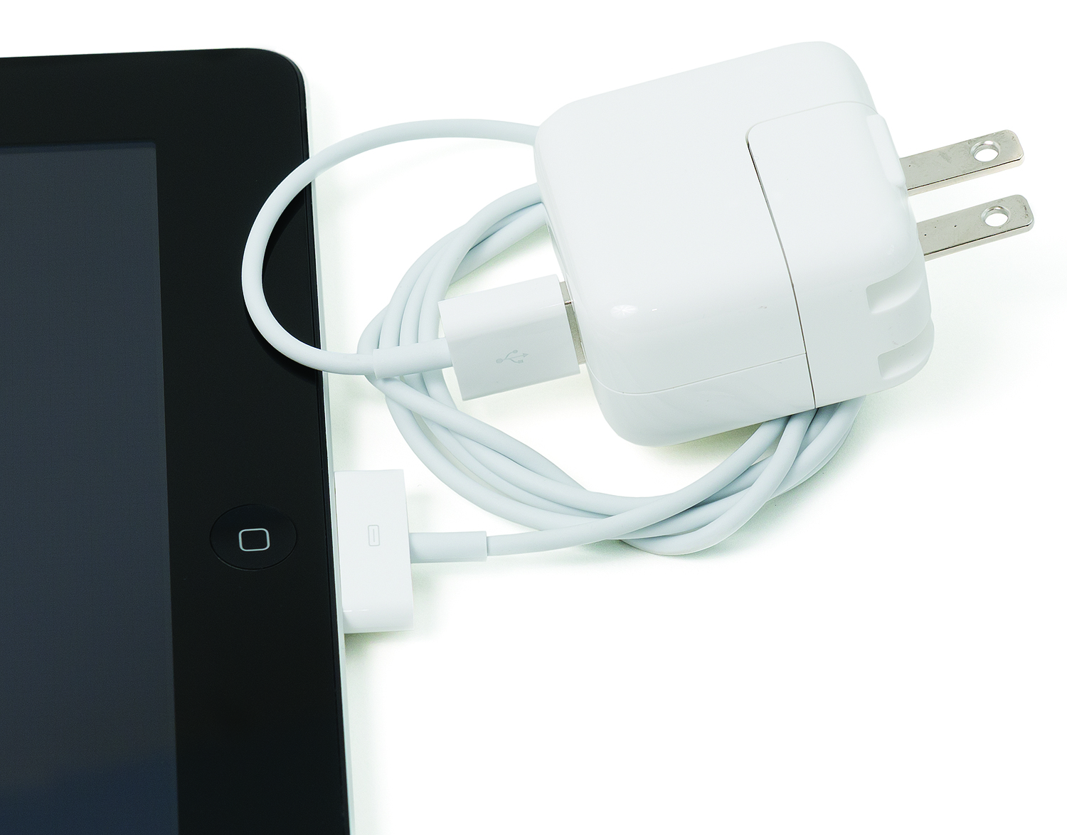
Enhancing Hardware
Apple expansion options
Apple devices offer the least expansion capability of all mobile devices.
Limited to proprietary cables and devices.
Figure 25.23 USB charger connected to proprietary port

Slide 40
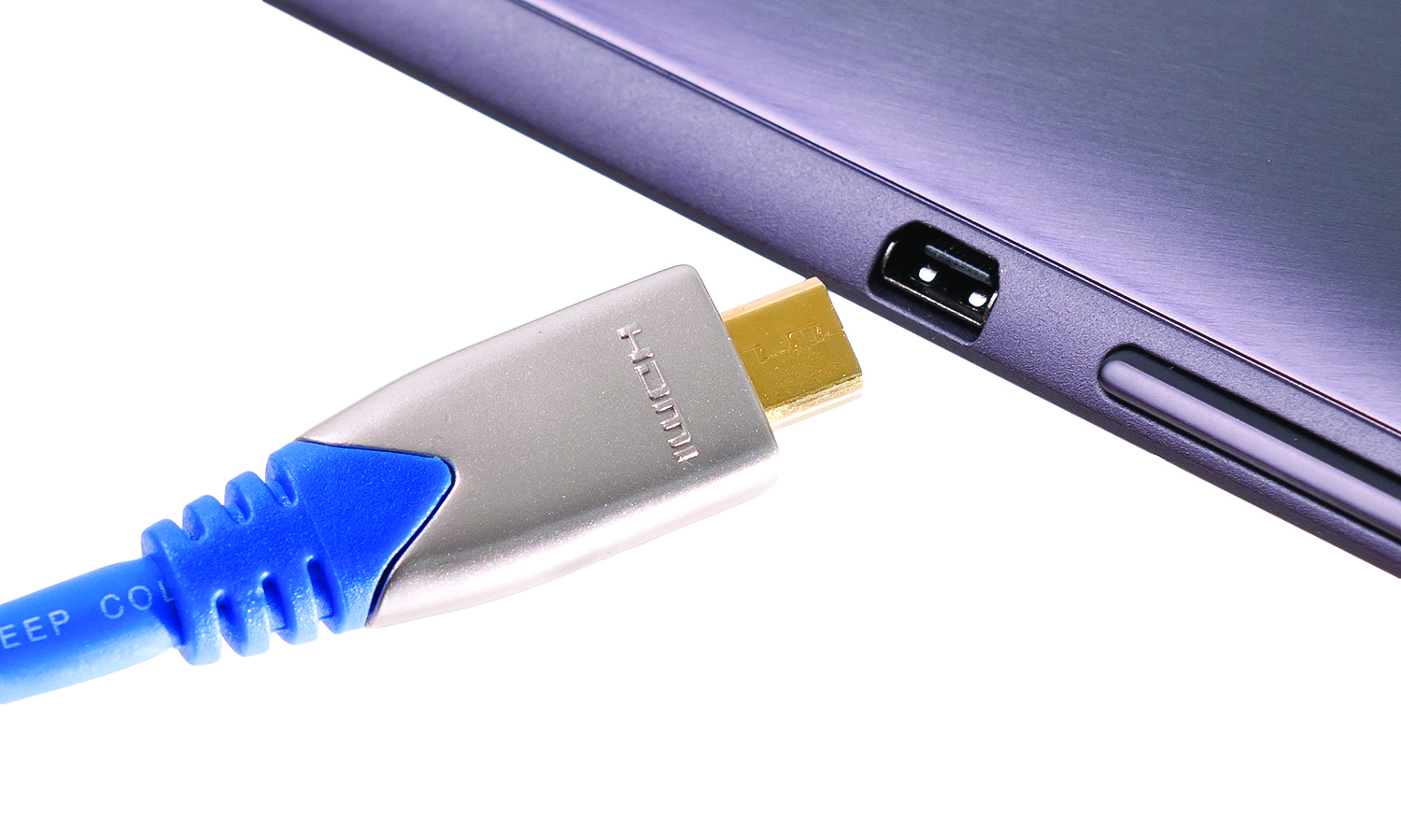
Enhancing Hardware
Android expansion options
Many offer microSD slots, and a few feature Micro USB or even full-sized USB ports.
Many tablets sport a connector for attaching the device to an external monitor, such as a big screen or projector.
Figure 25.28 Micro-HDMI port and connector

Slide 41
Enhancing Hardware
Bluetooth
The last way that mobile devices expand their physical capabilities is wirelessly, most often using the Bluetooth standard.
Traditionally, extending a mobile device with Bluetooth has meant adding a headset, mouse (though not with Apple iOS products), or keyboard.

Slide 42
Adding Apps
iOS apps
Apple maintains strict control over what apps can be installed onto iOS devices.
You can only get an app for your iPhone or iPad from the Apple App Store.
To add an app, select the App Store icon from the home screen.
iCloud Key Chain builds on the Key Chain feature in Mac OS X to synchronize user information, passwords, payment information, and other credentials with all of your Apple devices.

Slide 43
Adding Apps
Android apps
Despite the shared core OS, Android users familiar with devices from one manufacturer may get tripped up by the different interface on Android devices from a different maker.
Android devices can usually get apps from more than one source – Android’s default app store, Google Play, is most common.
Many manufacturers offer a store with apps developed or customized to work with Android devices.

Slide 44
Adding Apps
Windows phone apps
Microsoft closely mirrors Apple’s control of app development and distribution.
In terms of control and developer requirements, Microsoft’s app marketplace falls somewhere between that of Apple and Google.

Slide 45
Network Connectivity
Mobile devices connect to the outside world through the cellular networks or through various 802.11 Wi-Fi standards.
When you want to connect to a Wi-Fi network, enable Wi-Fi on your device and then actively connect to a network.
The Settings app enables you to do the vast majority of configuration necessary.
All mobile devices store network access information automatically, creating a profile for the network based on its SSID.

Slide 46
Data
Many mobile devices can use cellular data services.
By default, mobile devices that use cellular networks for Internet connectivity use data roaming—they jump from cell tower to cell tower and from your provider to another provider without obvious notice.
This can get expensive, especially outside your own country; turn data roaming off if you don’t need it.

Slide 47
E-mail
Every mobile device uses an e-mail service set up specifically from the mobile OS developer.
The 902 exam describes these options with the phrase: integrated commercial provider email configuration.
Mobile devices enable you to set up standard corporate and ISP e-mail configurations as well.

Slide 48
E-mail
TCP port numbers for various email protocols
POP3 uses TCP port 110.
IMAP4 uses TCP port 143.
SMTP uses TCP port 25.
Secure/Multipurpose Internet Mail Extensions (S/MIME) standard
Used to configure digital signature settings for e-mail, and contacts from the corporate address book

Slide 49
Synchronization
Smartphones and tablets can synchronize, or sync, with local machines or with cloud-based servers over the Internet.
Various mobile devices sync differently.
Depends upon the device vendor and software required.

Slide 50
Synchronization
Exchange ActiveSync (EAS) is a Microsoft protocol used to synchronize Microsoft Exchange e-mail, contacts, and calendars.
Widely used across a range of mobile OS platforms and hardware vendors

Slide 51
Synchronization
Synchronization methods
Each phone vendor has its own cloud technology that can tie to your user account and store personal data from your mobile device.
Apple has iCloud; Microsoft has OneDrive; and Google has Google Drive.
Independent cloud providers enable you to store your personal data, and even share it with others.
Single sign-on (SSO) is the process for using your active authenticated session with one of these common services to sign you into other services.

Slide 52
Synchronization
Synchronization issues
The most common synchronization issue is a connectivity, device, or remote infrastructure problem that leaves data partially synced.
There are other problems that prevent synchronization, including authentication issues, OS version issues, or incorrect configuration settings.

Slide 53
Synchronization
iTunes and iCloud
Apple iPhones and iPads can sync through Apple iTunes installed on a Mac or PC.
This single source for backup makes it easy to recover if something catastrophic happens to your Apple device.
With iCloud, you can have all your iPhone or iPad data backed up online and thus accessible anywhere.

Slide 54
Synchronization
Android and Gmail
Android-based mobile devices don’t have a central desktop application accomplishing what iTunes does for Apple devices.
Sync over the Internet

Slide 55
Mobile Device Communication and Ports
Micro-USB/mini-USB
Micro-USB or mini-USB connectors are standard on most Android and Windows devices.
We’re seeing fewer proprietary connectors as most device manufacturers are on the micro- and mini-USB bandwagon.
Lightning connector
With the iPhone 5, Apple introduced its most recent proprietary connector, known as the Lightning connector.
Lightning is an 8-pin connector, not “keyed”.

Slide 56
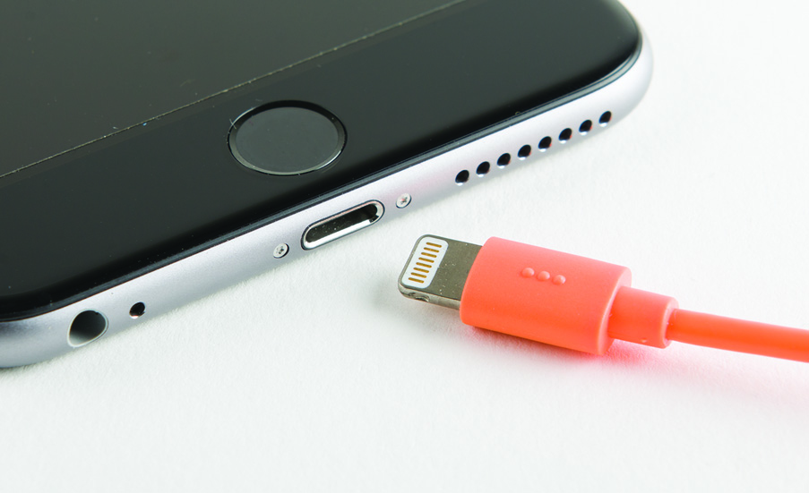
Mobile Device Communication and Ports
Figure 25.40 Lightning connector

Slide 57
Mobile Device Communication and Ports
USB Type-C
Newest USB connector
Not keyed, allowing it to be inserted right-side up or upside down
Supports up to 10 Gbps transfer rates
Bluetooth
Always remember to test the connectivity between a mobile device and a newly added Bluetooth accessory.

Slide 58
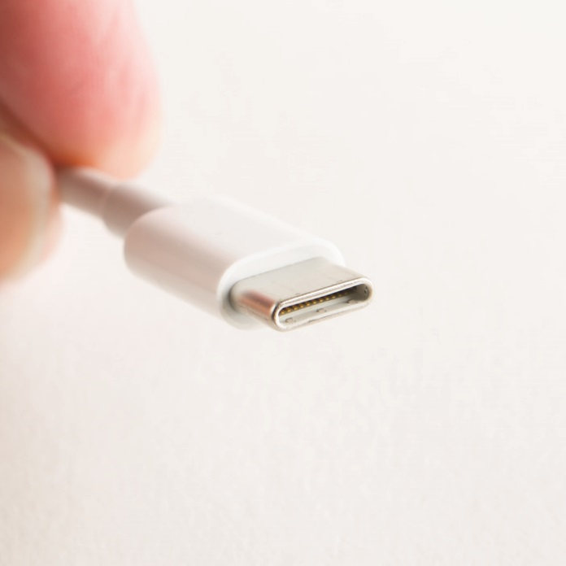
Mobile Device Communication and Ports
Figure 25.41 USB Type-C connector

Slide 59
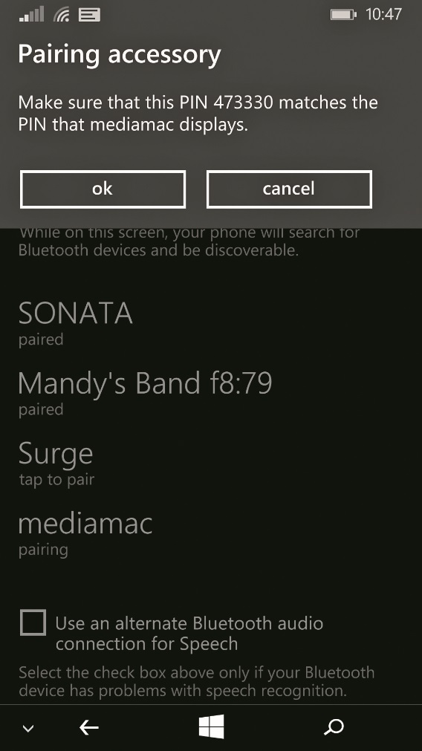
Mobile Device Communication and Ports
Figure 25.42 Prompting for PIN

Slide 60
Mobile Device Communication and Ports
NFC
Near Field Communication (NFC) uses chips embedded in mobile devices that create electromagnetic fields when devices are close to each other.

Slide 61
Mobile Device Communication and Ports
Infrared
Infrared (IR) was previously used to transfer data between mobile devices.
IrDA requires line of sight, meaning that devices have to be directly facing each other, requires very short distances between devices, and has very slow data rates.

Slide 62
Mobile Device Communication and Ports
Hotspots and tethering
A mobile hotspot is a small device that shares access to cellular technologies such as 3G, 4G, and 4G LTE via Wi-Fi.
Depending upon the carrier, many cellular phones, as well as tablets, can act as portable hotspots, referred to as tethering.
To configure a device as a hotspot, enable its cellular data connection, and turn on an additional hotspot setting that causes the device to broadcast a Wi-Fi network.

Slide 63
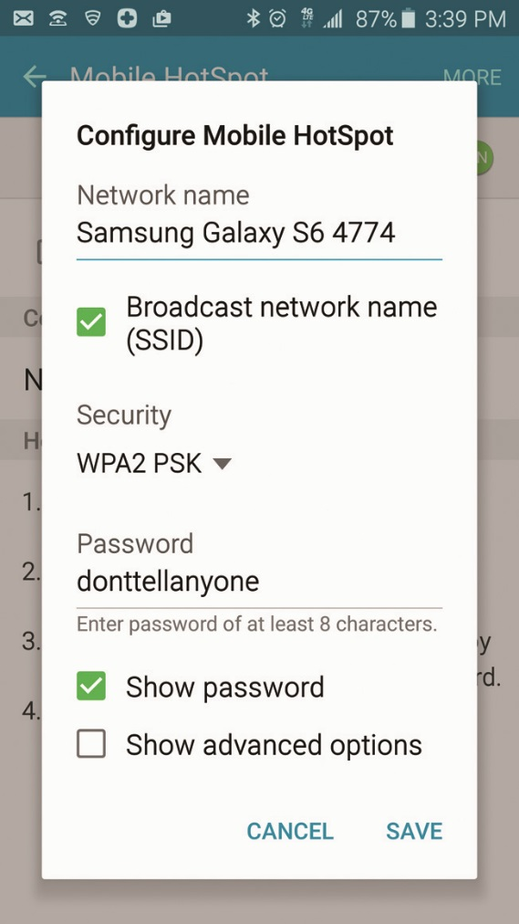
Mobile Device Communication and Ports
Figure 25.43 An Android phone acting as a portable hotspot

Slide 64
Mobile Device Communication and Ports
Accessories
Bluetooth headsets and high-quality external speakers
Gamepads
Removable external storage, such as miniSD or microSD memory cards
Extra battery packs
Device chargers
Docking stations
Credit card readers
Cover

Slide 65


Slide 66
Summary
Explain the features and capabilities of mobile devices
Describe the three major mobile operating systems
Describe how to configure mobile devices

Slide 67


